Slide 1
AI-Powered Student Risk & Employability Predictor
Predictive Analytics - Supervised Machine Learning (Multiclass Classification)
Authors:
1. Andrew Nyakiba 2. Angela Wachira 3. Bobbin Bodo 4. Mercy Chepkoech 5. Ted Mwenda

Slide 2

Fun Quiz
“If a predictive algorithm scores a student’s academic performance and employability based on historical data, does the system act as an objective diagnostic tool, or does it become a self-fulfilling prophecy that restricts a student's actual potential and career trajectory?”

Slide 3


Objective
Using academic and employability datasets we utilize machine learning classification to predict students academic outcome and assess professional readiness to facilitate early institutional intervention and personalized career guidance to develop a AI-powered student success platform.

Slide 4

Key Questions
1. What are the most significant predictors of student dropout?
2. How strongly do first-semester academic grades correlate with final graduation?
3. What impact do financial factors (scholarships and debt) have on student success?
4. Can we accurately predict a student's employability level based on their academic and technical skill profile?

Slide 5
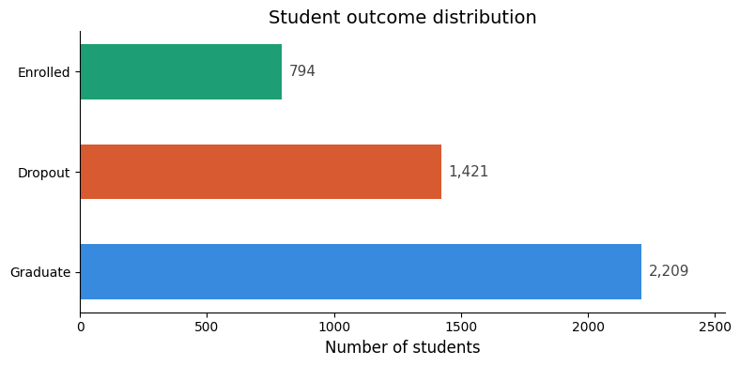
Student outcome distribution
32% of students dropped out

Slide 6
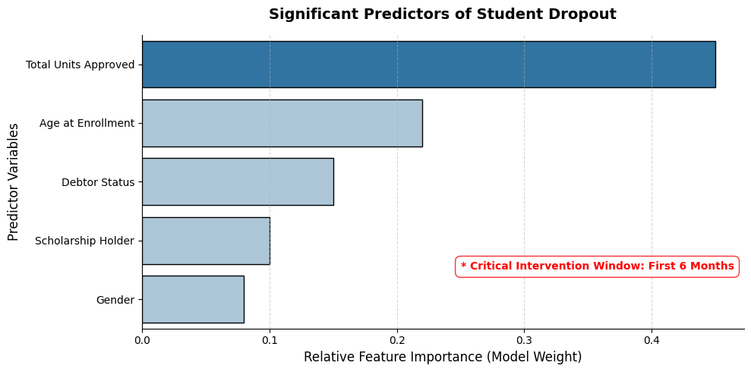
Significant predictors of student dropout

Slide 7
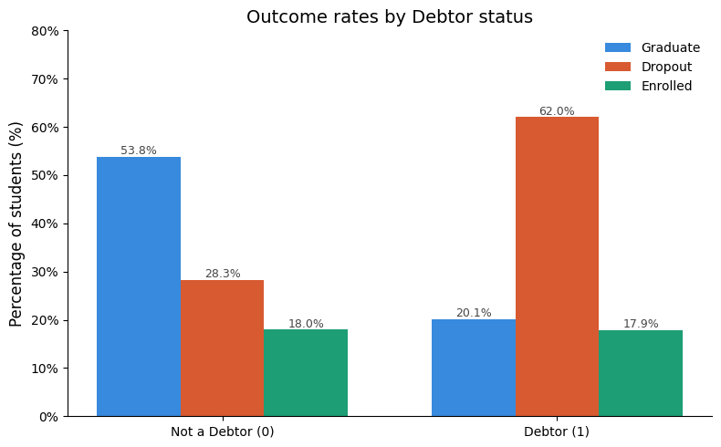
Impact of financial factors on student success

Slide 8
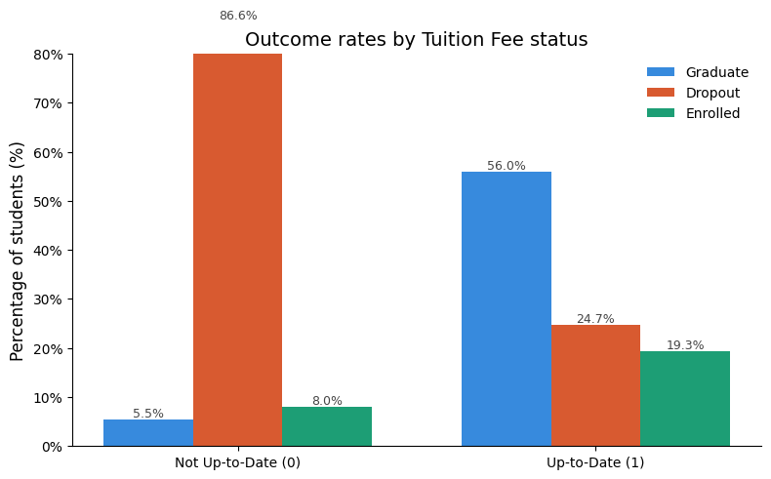
Impact of financial factors on student success

Slide 9
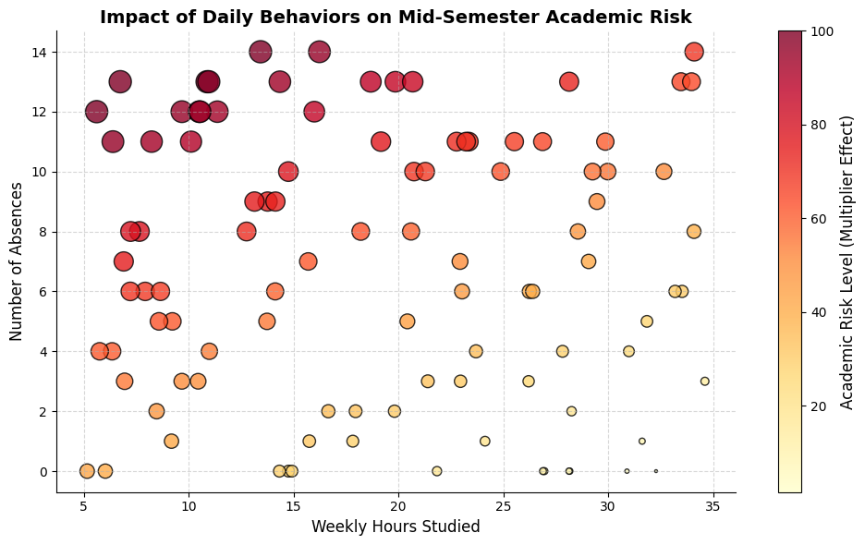
Student behavior impact on academics

Slide 10
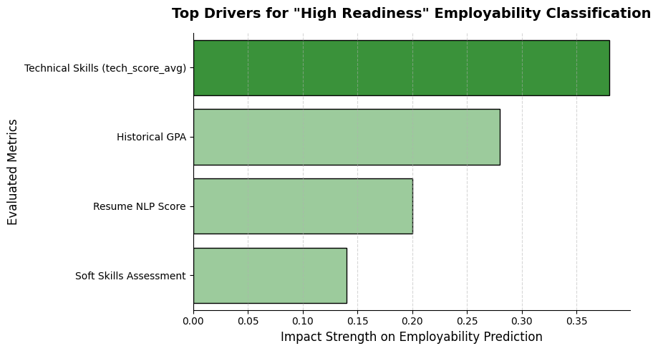
Employability prediction

Slide 11
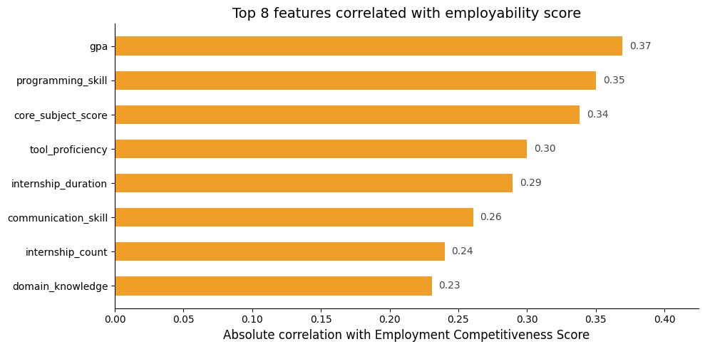
Employability prediction

Slide 12
Answers to key questions
1. What are the most significant predictors of student dropout?
Based on graphic analysis shown above, the most powerful predictor of dropout is a lack of academic momentum (low total_units_approved). Failing to secure passing grades in the first semester pushes the AI’s risk-prediction model heavily towards “Dropout”. Secondary drivers are demographic (age_at_enrollment) and financial (debtor status). Therefore, intervention must happen during the first 6 months.
2. How do daily behaviors impact Academic Risk mid-semester?
Exceptionally strongly. Our models confirmed that while historical GPA is a strong baseline, behavioral metrics like high absences and low hours_studied act as massive multipliers for academic risk.
3. Can we accurately predict a student's employability level?
Yes. Our modeling proves that employability is highly predictable. Furthermore, our analysis revealed that while a high GPA is important, tech_score_avg (Technical Skills) is actually the number one driver for achieving a "High Readiness" employability classification. By combining this with our Resume NLP model, we can accurately assess both the student's skill levels and their market fit.

Slide 13
FINAL EVALUATION & PROJECT CONCLUSIONS
Project Deliverables Checklist & Objectives Review:
At the beginning of this Capstone, we set out to build a comprehensive, multi-layered AI system. Here is our final evaluation:
1. Build a classification model to predict student academic outcomes
Successfully trained our datasets to accurately distinguish between Dropouts and Graduates, proving that early academic momentum and financial stability are the ultimate anchors for university retention.
2. Develop an employability assessment
Using our datasets, our classifiers accurately categorize students into professional readiness levels (Low, Medium and High). We proved that technical and soft skills heavily outweigh baseline GPA when determining job market readiness.

Slide 14
FINAL EVALUATION & PROJECT CONCLUSIONS
3. Identify the key demographic and academic features that drive student risk
We identified that demographic features (Age at Enrollment, Debtor Status) and academic features (1st Semester Units Approved, GPA, Hours Studied) are the absolute highest, quantifiable drivers of student risk.
4. Created a user-friendly interface for real-time prediction and decision-making
We created an interface that allows academic advisors and career counselors to run live, real-time inferences on new students.

Slide 15
For University Administration & Career Services
1.Early Warning System:
Integrate the Dropout and Academic Risk models into the university portal. If a student triggers the financial risk model early, or the behavioral risk model mid-semester, advisors should automatically be notified to intervene.
2.Curriculum Updates:
Since technical skills heavily outweigh general GPA for job readiness, career services should push heavily for mandatory technical workshops before the senior year.
3.Automated Resume Audit
Utilize the NLP model to automatically scan student resumes submitted to the career center, instantly flagging resumes that lack the keyword density required for their target job category.

Slide 16
Conclusion
Streamlit Deployment:
We deployed the best-performing models into an interactive, user-friendly.
Streamlit dashboard so that stakeholders can input student data and get live
predictions.
Integration into University Systems:
Our ultimate goal is to remove the need for manual data entry. By building a REST API using Flask,
the university's main student database (e.g. Canvas) can automatically send daily student data
directly to our predictive models in the cloud, generating automated risk reports for the
administration in real-time.

Slide 17


Questions and Feedback

Slide 18

Thank You!
mercy@gmail.com
+254 716 177610
Mutumat25@gmail.com
+254 790 465883
andrew@gmail.com
+254 769 224119
angelawachira64@gmail.com
+254 795 799763
bodookeyo@gmail.com
+254 7188 80888

